Slide 1
PRESENTATION ON APPLICATION OF KNOWLEDGE ACQUIRED FROM MATLAB LECTURE MODULES ONE TO FOUR
By GROUP 18

Slide 2
Details of Group 18 Members
 | NAME | REG NUMBER | PROGRAM
1 | UHURU DENISH BRIAN | BU/UP/2024/3841 | WAR
2 | TUMUHAISE SARAH | BU/UG/2024/2674 | AMI
3 | MUKHOOLI ELIJAH | BU/UG/2024/2586 | MEB
4 | OMARA PASCHAL KELLY | BU/UP/2024/1063 | WAR
5 | AUMA DIANA | BU/UP/2024/1020 | WAR
6 | NANDAULA CATHERINE | BU/UP/2024/4322 | AMI
7 | NABAWEESI CLAIRE | BU/UP/2024/1046 | WAR
8 | ENAMU REAGAN EGIMU | BU/UG/2024/2672 | APE
9 | NAKAWEESA LINNET | BU/UP/2024/4327 | APE
10 | OLUK CHRISTIAN GLEN | BU/UP/2024/3842 | WAR

Slide 3
Questions o the Assignment
Question 1
Retrieve a unique data set from kaggle.com in Excel format. Write a single MATLAB script to:
Read the dataset into MATLAB
Copy variables for each year
Display data for each year in separate tables
Convert the tables from (3) into structural arrays
Output the variables from the structural arrays into one excel workbook and separate sheets for data of each year with clear column headings
Question 2
Each group has different members from different backgrounds, home districts, religions ,tribes, villages, Courses , interests , ages , names, and facial representations
Write a MATLAB code that can store each member’s attributes into a single variable. Ensure the code saves the variable.

Slide 4
Solution to Question 1
The first question focused on data manipulation, specifically the process of importing a dataset from Kaggle, structuring it for analysis, and exporting it to an organized Excel workbook.
The primary objective of this exercise was to create a MATLAB script suitable for handling an external dataset. Our approach was a three-step process, i.e.: Data Acquisition, Importation, and Data Processing

Slide 5
Codes used
Below is the code we used to write a script that would accomplish our intended task, we saved the “group18.mlx” script into our exercise folder and executed the script using the Run command in our MATLAB IDE
In the code below;
mat represents a dataset retrieved from Kaggle.com
mats represents table to structural array
matst represents structural array to table
%reading table into matlab
mat = readtable("IMDB-Movie-Data.xlsx","ReadVariableNames",true)
disp(mat)
%TABLES OF EACH YEAR
mat2006 = mat(mat.Year==2006, :)
mat2007 = mat(mat.Year==2007, :)
mat2008 = mat(mat.Year==2008, :)
mat2009 = mat(mat.Year==2009, :)
mat2010 = mat(mat.Year==2010, :)
mat2011 = mat(mat.Year==2011, :)
mat2012 = mat(mat.Year==2012, :)

Slide 6
Cont’n of Codes
mat2013 = mat(mat.Year==2013, :)
mat2014 = mat(mat.Year==2014, :)
mat2015 = mat(mat.Year==2015, :)
mat2016 = mat(mat.Year==2016, :)
%CONVERTING TABLES INTO STRUCT ARRAYS
mats2006=table2struct(mat2006)
mats2007=table2struct(mat2007)
mats2008=table2struct(mat2008)
mats2009=table2struct(mat2009)
mats2010=table2struct(mat2010)
mats2011=table2struct(mat2011)
mats2012=table2struct(mat2012)
mats2013=table2struct(mat2013)
mats2014=table2struct(mat2014)
mats2015=table2struct(mat2015)
mats2016=table2struct(mat2016)

Slide 7
Cont’n of Codes
%CONVERTING THE STRUCT INTO TABLE ARRAYS
matst2006 = struct2table(mats2006)
matst2007 = struct2table(mats2007)
matst2008 = struct2table(mats2008)
matst2009 = struct2table(mats2009)
matst2010 = struct2table(mats2010)
matst2011 = struct2table(mats2011)
matst2012 = struct2table(mats2012)
matst2013 = struct2table(mats2013)
matst2014 = struct2table(mats2014)
matst2015 = struct2table(mats2015)
matst2016 = struct2table(mats2016)
writetable(matst2006,"test.xlsx","sheet","2006")
writetable(matst2007,"test.xlsx","sheet","2007")
writetable(matst2008,"test.xlsx","sheet","2008")
writetable(matst2009,"test.xlsx","sheet","2009")
writetable(matst2010,"test.xlsx","sheet","2010")

Slide 8
Cont’n of Codes
writetable(matst2011,"test.xlsx","sheet","2011")
writetable(matst2012,"test.xlsx","sheet","2012")
writetable(matst2013,"test.xlsx","sheet","2013")
writetable(matst2014,"test.xlsx","sheet","2014")
writetable(matst2015,"test.xlsx","sheet","2015")
writetable(matst2016,"test.xlsx","sheet","2016")

Slide 9
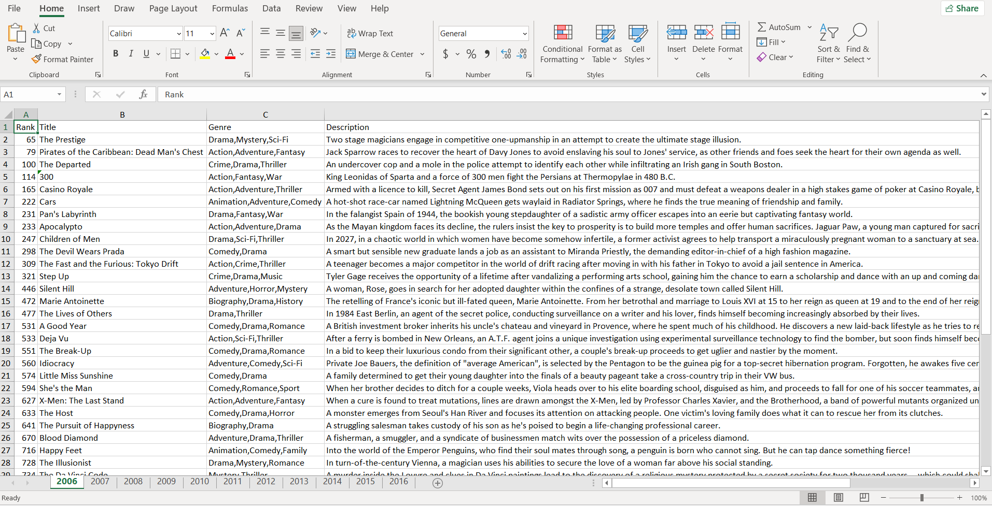
A sample of the Output of variables from the structural arrays

Slide 10
Solution to Qn.2: Group Member Data Storage
This exercise focused on a different aspect of data management: structuring varied data types into a single variable. The task was to take a set of attributes for each group member including home district, religion, tribe, interests, age, name, and a description for facial representation and store them collectively.
To accomplish this, we utilize a structural array. Each element of the array represents a single group member, and each field within that element (e.g., .name, .age, .interests) holds the corresponding attribute. This approach allows for logical grouping of related data and simplifies future access and manipulation of the information.
Our main task here is to get the data into the MATLAB environment. Using Script, we enter values for the attributes of the deferent group members while utilizing a loop for this. We enter the group size in terms of number o members and iterate the attribute prompts for each member.

Slide 11
Codes used
Below is the code for the MATLAB script we used to achieve the intended outcome of the exercise.
%%Defining struct
members = struct('Name',{},'Age',{},'course',{},'HomeDistrict',{},'Interest',{},'Tribe',{},'Background',{},'FacialRepresentation',{},'Village',{},'Religion',{});
%member1
members(1).Name = 'MUKHOOLI ELIJAH';
members(1).Age = 28;
members(1).course = 'MEB';
members(1).HomeDistrict = 'Mbale';
members(1).Interest = 'Researching';
members(1).Tribe = 'Gishu';
members(1).Background = 'Humble';
members(1).FacialRepresentation = imread("IMG-20250907-WA0008.jpg");
members(1).Village = 'Bugema Cell';
members(1).Religion = 'Pentacostal';

Slide 12
Cont’n of Codes
%member2
members(2).Name = 'AUMA DIANA';
members(2).Age = 22;
members(2).course = 'WAR';
members(2).HomeDistrict = 'Oyam';
members(2).Interest = 'Watching';
members(2).Tribe = 'Lango';
members(2).Background = 'Humble';
members(2).FacialRepresentation = imread("IMG-20250911-WA0015.jpg");
members(2).Village = 'Aringolworo';
members(2).Religion = 'Catholic';
%member3
members(3).Name = 'UHURU BRIAN DENISH';
members(3).Age = 21;
members(3).course = 'WAR';
members(3).HomeDistrict = 'Lamwo';
members(3).Interest = 'Video Game';
members(3).Tribe = 'Acholi';
members(3).Background = 'Humble';
members(3).FacialRepresentation = imread("IMG-20250907-WA0008.jpg");
members(3).Village = 'Okokwene';
members(3).Religion = 'Catholic';

Slide 13
Cont’n of Codes
%member4
members(4).Name = 'TUMUHAISE SARAH';
members(4).Age = 21;
members(4).course = 'AMI';
members(4).HomeDistrict = 'Hoima';
members(4).Interest = 'Cooking';
members(4).Tribe = 'Runyoro';
members(4).Background = 'Humble';
members(4).FacialRepresentation = imread("IMG-20250911-WA0018.jpg");
members(4).Village = 'Katasiha';
members(4).Religion = 'Anglican';
%member5
members(5).Name = 'NABAWEESI CLAIRE';
members(5).Age = 20;
members(5).course = 'WAR';
members(5).HomeDistrict = 'Mityana';
members(5).Interest = 'Watching animations';
members(5).Tribe = 'Muganda';
members(5).Background = 'Humble';
members(5).FacialRepresentation = imread("IMG-20250907-WA0007.jpg");
members(5).Village = 'Wabigalo';
members(5).Religion = 'Catholic';

Slide 14
Cont’n of Codes
%member6
members(6).Name = 'NANDAULA CATHERINE';
members(6).Age = 21;
members(6).course = 'AMI';
members(6).HomeDistrict = 'Buvuma';
members(6).Interest = 'Baking';
members(6).Tribe = 'Muganda';
members(6).Background = 'Humble';
members(6).FacialRepresentation = imread("IMG-20250911-WA0010.jpg");
members(6).Village = 'Bugaya';
members(6).Religion = 'Bornagain';
%member7
members(7).Name = 'OMARA PASCHAL KELLY';
members(7).Age = 21;
members(7).course = 'WAR';
members(7).HomeDistrict = 'Oyam';
members(7).Interest = 'Singing';
members(7).Tribe = 'Lango';
members(7).Background = 'Humble';
members(7).FacialRepresentation = imread("IMG-20250911-WA0013.jpg");
members(7).Village = 'Aringoarum';
members(7).Religion = 'Catholic';

Slide 15
Cont’n of Codes
%member8
members(8).Name = 'ENAMU REAGAN EGIMU';
members(8).Age = 21;
members(8).course = 'APE';
members(8).HomeDistrict = 'Soroti';
members(8).Interest = 'Soccer';
members(8).Tribe = 'Itesot';
members(8).Background = 'Humble';
members(8).FacialRepresentation = imread("IMG-20250911-WA0007.jpg");
members(8).Village = 'Owalei';
members(8).Religion = 'Catholic';
%member9
members(9).Name = 'OLUK CHRISTIAN GLEN';
members(9).Age = 21;
members(9).course = 'WAR';
members(9).HomeDistrict = 'Apac';
members(9).Interest = 'Playing Football';
members(9).Tribe = 'Lango';
members(9).Background = 'Humble';
members(9).FacialRepresentation = imread("IMG-20250911-WA0017.jpg");
members(9).Village = 'Akokoro';
members(9).Religion = 'Catholic';

Slide 16
Cont’n of Codes
%member10
members(10).Name = 'NAKAWEESA LINNET';
members(10).Age = 21;
members(10).course = 'APE';
members(10).HomeDistrict = 'Mukono';
members(10).Interest = 'Food';
members(10).Tribe = 'Muganda';
members(10).Background = 'Humble';
members(10).FacialRepresentation = imread("IMG-20250911-WA0021.jpg");
members(10).Village = 'Mukono';
members(10).Religion = 'Bornagain';
save("test.mat","members")

Slide 17
Conclusion
Getting the dataset from Kaggle.com was quite a problem because most of them had information which did not meet our goal according to the first question of the assignment. Using reliable variables, functions to run the code was quite challenging.
On completing the assignment, we were able to learn how to retrieve data from Kaggle.com, run codes and see the coded results.
At first we had a challenge of some of our codes failing to run, but due to our dedication and persistence kept us swaying through the hurdles, made corrections until we had our codes running as programmed.

